Slide 1
Chapter 17
The Dark Side of Leadership
Copyright ©2022 McGraw-Hill Education. All rights reserved. No reproduction or distribution without the prior written consent of McGraw-Hill Education.

Slide 2
Chapter Outline
Introduction
Destructive leadership
Managerial incompetence
Managerial derailment
The ten root causes of managerial incompetence and derailment

Slide 3
The Dark Side of Leadership
"If you put on a blindfold and threw a dart at a map of the world, then there is a 70 percent chance that whatever country the dart lands on is run by some form of dictatorship."
RT Hogan, Hogan Assessment Systems

Slide 4
Introduction
There is a high level of agreement among scientists and practitioners on what constitutes bad leadership.
Destructive leadership.
    Associated with individuals who are effective at engaging followers, building teams, and getting results through others, but who obtain results that are morally or ethically challenged or that undermine success.
Managerial incompetence.
    Inability to engage followers, build teams, or get results through others.
Managerial derailment.
    Describes the reasons why people in positions of authority have difficulty engaging followers, building teams, or getting results through others.

Slide 5
Destructive Leadership
Occurs in many settings and at all organizational levels.
Occurs when people in positions of authority use their team-building skills to achieve greedy, selfish, or immoral results.
May be in the eye of the beholder.

Slide 6
Managerial Incompetence 1
Incompetent managers have difficulties building loyal followings or getting anything done.
Base rate of managerial incompetence may be 50 to 75 percent.
One way to determine the level of incompetence among people in positions of authority is to conduct the Dr. Gordy test.
The person should count the total number of people that he or she has been led by or worked for in the past.
Then count the number of people in this group for whom he or she would willingly play, sing, or work for again.
Most people would not work for a majority of leaders they have been exposed to.

Slide 7
Managerial Incompetence 2
Organizations may not need every person in a position of authority to be a competent manager.
    Organizations with higher percentages of competent managers occupying critical positions are more successful than those with fewer competent managers who are not well placed.

Slide 8
Managerial Derailment 1
Research has identified five derailment patterns.
Failure to meet business objectives.
Inability to build and lead a team.
Inability to build relationships with co-workers.
Inability to adapt to new bosses, businesses, cultures, or structures.
Inadequate preparation for promotion.

Slide 9
Managerial Derailment 2
Presence of only one behavioral pattern is not enough for derailment except for a failure to meet business objectives.
The five reasons for failure are universal.
Awareness of why people fail in leadership positions is not enough to prevent failure.
Knowing the root causes of managerial incompetence and what to do to minimize their impact improves the odds of being perceived as a competent manager.

Slide 10
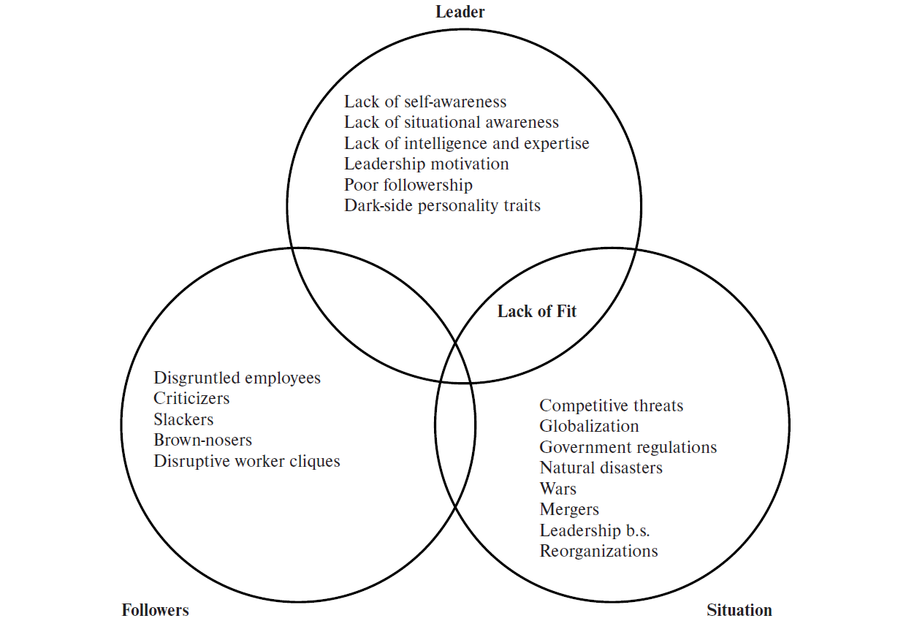
Figure 17.1: Why Leaders Fail
Access the text alternative for slide images.

Slide 11
The Ten Root Causes of Managerial Incompetence and Derailment
Situational factors
Follower factors
Lack of organizational fit
Lack of situational awareness
Lack of self-awareness
Lack of intelligence and subject matter expertise
Poor followership
Dark-side personality traits
Leadership motivation
Myths that perpetuate managerial incompetence

Slide 12
Situational and Follower Factors 1
Affect a person’s ability to engage followers, build teams, and get results.
Managers should control their reactions to overwhelming situational and follower factors.
Incompetent managers facing hopeless situations:
    Tend to keep doing what they have always done but expect to achieve different results.
    Try to leverage their strengths rather than change, which erodes their ability to build teams and get results.
Situational factors can mask managerial incompetence.

Slide 13
Situational and Follower Factors 2
Episodic versus chronic incompetence.
Episodic managerial incompetence: Occurs when extremely tough situational or follower events temporarily interfere with a person’s ability to build teams and get results.
    Experienced by all competent managers occasionally.
    Frequency and duration of occurrences should be limited.
Chronic managerial incompetence: Occurs when taxing situational or follower events permanently disrupt a person’s ability to build teams or get results.
    Many people in positions of authority seem to exemplify chronic managerial incompetence.

Slide 14
Lack of Organizational Fit
Organizational fit: Degree of agreement between personal and organizational values and beliefs.
People who do not fit with an organization’s culture may wield diminishing levels of influence, which interferes with their ability to engage followers, build teams, and get results.
The best thing to avoid being seen as organizational culture misfits is to minimize the risk of it happening at all.
Those who do not fit run the risk of being seen as incompetent.

Slide 15
Lack of Situational and Self-Awareness
Situational awareness: Leaders’ ability to identify the situational and follower factors affecting their teams and remain vigilant for changes.
Self-awareness: Leaders’ ability to be aware of personal strengths and shortcomings and to find ways to either manage or staff around their personal knowledge and skill gaps.
Causes
Managers suffering from a highly active reality distortion field.
  They only take in information that is aligned with their self-perceptions and discount any evidence to the contrary.
Managers failing to heed direct report feedback.

Slide 16
Lack of Intelligence and Subject Matter Expertise
Managers’ intelligence is directly related to their ability to make decisions and build cohesive teams and get results.
Shortfall in critical knowledge decreases a person's ability to solve problems and a lack of team-building know-how increase the odds of managerial competence.
Subject matter expertise: Relevant knowledge or experience that can be leveraged to solve problems.
Team-building know-how: Degree to which a leader knows the steps and processes needed to build high-performing teams.
Can be compensated for by technology and staffing, surrounding oneself with smart, experienced people, and through hard work.

Slide 17
Poor Followership
People in positions of authority who are criticizers, brown-nosers, and slackers are seen as incompetent managers.
Brown-nosers do whatever their superiors tell them to do and are unable to make independent decisions.
Slackers are so disconnected from the workplace that they are unlikely to build teams or get results.
Criticizers are not nice to be working around.
Followership affects how one leads and determines whether one is seen as a competent or incompetent manager.

Slide 18
Dark-Side Personality Traits
Irritating, counterproductive behavioral tendencies that interfere with a leader’s ability to build cohesive teams and cause followers to exert less effort toward goal accomplishment.
Decrease a leader’s ability to get results through others.
Usually appear during crises or periods of high stress.
Have a bigger influence on the performance of leaders than followers.
Apparent only when leaders are not attending to their public image.
Resemble social skills and are hard to detect in interviews.
Related to extreme FFM or OCEAN scores.
Can occur at any leadership level.
Are the leading cause of managerial incompetence.

Slide 19
Table 17.2: Dark-Side Personality Traits 1
Traits | Characteristics
Excitable | Leaders with these tendencies have difficulties building teams because of their dramatic mood swings, emotional outbursts, and inability to persist on projects.
Skeptical | Leaders with this dark-side trait have an unhealthy mistrust of others, are constantly questioning the motives and challenging the integrity of their followers, and are vigilant for signs of disloyalty.
Cautious | Because these leaders are so fearful of making “dumb” mistakes, they alienate their staffs by not making decisions or taking action on issues.
Reserved | During times of stress these leaders become extremely withdrawn and are uncommunicative, difficult to find, and unconcerned about the welfare of their staffs.

Slide 20
Table 17.2: Dark-Side Personality Traits 2
Traits | Characteristics
Leisurely | These passive–aggressive leaders will exert effort only in the pursuit of their own agendas and will procrastinate on or not follow through with requests that are not in line with their agendas.
Bold | Because of their narcissistic tendencies, these leaders often get quite a bit done. But their feelings of entitlement, inability to share credit for success, tendency to blame their mistakes on others, and inability to learn from experience often result in trails of bruised followers.
Mischievous | These leaders tend to be quite charming but take pleasure in seeing if they can get away with breaking commitments, rules, policies, and laws. When caught, they also believe they can talk their way out of any problem.

Slide 21
Table 17.2: Dark-Side Personality Traits 3
Traits | Characteristics
Colorful | Leaders with this tendency believe they are “hot” and have an unhealthy need to be the center of attention. They are so preoccupied with being noticed that they are unable to share credit, maintain focus, or get much done
Imaginative | Followers question the judgment of leaders with this tendency because these leaders think in eccentric ways, often change their minds, and make strange or odd decisions
Diligent | Because of their perfectionist tendencies, these leaders frustrate and disempower their staffs through micromanagement, poor prioritization, and an inability to delegate
Dutiful | These leaders deal with stress by showing ingratiating behavior to superiors. They lack spines, are unwilling to refuse unrealistic requests, won’t stand up for their staffs, and burn them out as a result

Slide 22
Leadership Motivation
Those who lack the motivation to lead will most likely make poor leaders.
Team members who are smart, have plenty of expertise, and have no dark-side personality traits may be promoted into leadership roles.
    People being promoted may have questionable leadership skills and no desire to lead but may accept the promotion out of gratitude.
Those wanting to become leaders need to be clear on their reasons for moving into positions of authority.
People have a choice when it comes to getting promoted, but their choices will have a profound impact on the people they lead.

Slide 23
Successful versus Effective Leaders
Successful leaders: Network, stay on top of office politics, flatter superiors, do what their superiors want, demonstrate loyalty, do not make any waves, and self-promote.
Effective leaders: Engage and develop followers, secure resources, clear obstacles, build high-performing teams, devise strategies to win, and drive results.

Slide 24
Myths That Perpetuate Managerial Incompetence
Leadership concepts that are adopted with the right intentions but contribute to managerial incompetence problems.
Leader humility: Reduces the chances of being promoted.
Authenticity: Followers want leaders who can adjust their behavior to situational and follower demands and keep their egos under control.
Integrity: Leaders often break commitments, and followers end up trusting the wrong people.
  Servant leadership makes sense; if leaders take care of their followers, then followers will take care of customers and teams will achieve winning results.

Slide 25
Summary
There are many ways for people in positions of authority to fail, and most people are not particularly effective leaders.
What constitutes good or destructive leadership may not be straightforward.
People with managerial incompetence have difficulties engaging followers, building teams, or getting results through others.
Managerial derailment pertains to the reasons why competent managers can be seen as ineffective, and knowing the reasons is not enough to prevent it from happening.
Leaders and leaders-to-be can take steps to mitigate the impact of the root causes for managerial incompetence and derailment on their ability to build teams and get results.

Slide 26
End of Main Content
Copyright ©2022 McGraw-Hill Education. All rights reserved. No reproduction or distribution without the prior written consent of McGraw-Hill Education.

Slide 27
Accessibility Content: Text Alternatives for Images

Slide 28
Figure 17.1: Why Leaders Fail - Text Alternative
Return to parent-slide containing images.
The three intersecting circles of the Venn diagram represent followers, the leader, and the situation. The circle representing followers contains content that reads disgruntled employees, criticizers, slackers, brown-nosers, and disruptive worker cliques. The circle representing the situation reads competitive threats, globalization, government regulations, natural disasters, wars, mergers, leadership b.s., and reorganizations. The circle representing the leader reads lack of self-awareness, lack of situational awareness, lack of intelligence and expertise, leadership motivation, poor followership, and dark-side personality traits. The area of intersection between the circle representing the leader and the circle representing the situation is labeled lack of fit.
Return to parent-slide containing images.

